Slide 1
Subex Limited
Investor Presentation – Q4FY20
May 11, 2020

Slide 2

Forward looking statement
Certain statements in this presentation concerning our future growth prospects are forward looking statements, which involve a number of risks, and uncertainties that could cause actual results to differ materially from those in such forward looking statements. The risks and uncertainties relating to these statements include, but are not limited to, fluctuations in earnings, our ability to successfully integrate acquisitions, competition in our areas of business, client concentration, liability for damages in our contracts, withdrawal of tax incentives, political instability, unauthorized use of our intellectual property and general economic conditions affecting our industry

Slide 3


Agenda
Company Overview
Investment Rationale
Quarterly Financial Performance
Awards & Recognitions

Slide 4
Company Overview

Slide 5



Snapshot
Financial Performance FY20
Leading telecom analytics solution provider
Pioneer in enabling Digital Trust for businesses globally
Focus on privacy, security, risk mitigation, predictability and confidence in data
REVENUE
Nature of Business
5%
₹ 3,649.8 Mn
EBITDA
(ex-forex)
Managed by handpicked professionals from a cross-section of the industry
Supported by an experienced second in line management team
Margin
23.6%
Management
₹ 861.8 Mn
Profit
(Before Tax & Exceptional Item)
Revenue Management
Network Management
Partner Management
IOT Security
Products
70%
₹ 799.6 Mn

Slide 6









Subex Today
1994
+
Years of Experience
800+
Foundation of
Company
Employees
300+
90+
200+
Global Installations
Countries
Customers
Globally
35+
US$ 3.1mn
US$ 44 mn
Industry Awards
R&D spend in new areas
Order Book in FY20

Slide 7





Vision Statement
PURPOSE
VISION
Experience the thrill of unlocking possibilities
Unlocking possibilities by being the World Leader in digital trust
OUR VALUES
THINK CUSTOMER
MAKE IT HAPPEN
DELIVER VALUE
BE OPEN. BE FAIR.
WIN TOGETHER
Largest & most trusted player in digital trust as measured by number of devices, users and amount of data transactions

Slide 8
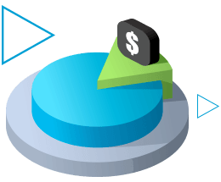


3 Horizon Strategy for Growth
Horizon 1
Horizon 2
Horizon 3
Core areas
Immediate Growth
Long Term Growth
Enhance the core
Growth in new areas
Invest in
Emerging Areas
(Multi-Vertical SaaS)
Revenue Assurance
Fraud Management
Asset Assurance
Partner Management
Network Analytics
IoT Security (Multi-vertical product)
Analytics
Crunch Metrics
Digital Identity
Successful execution of strategy will create substantial value for all stakeholders

Slide 9






Subex – Partner for Digital Trust
Digital Security • Digital Identity • Anomaly Detection • Network Analytics • Business Assurance • Fraud Management • Partner Management • Augmented Analytics
Subex Portfolio
Identity
Predictability
Security
Confidence
in Data
Privacy
Risk
Mitigation
Digital Trust

Slide 10
Investment Rationale
Leader in Digital Trust space and help businesses thrive by leveraging Digital Trust as a competitive advantage
Making strong inroads in the multi vertical IoT Security space; IoT Security Market is expected to touch US$ 4.5 billion by 2022
Incubating virtual startups within the organization to diversify into new areas and verticals
Sticky Revenue Model with long client relationship
Investing heavily in newer areas like Digital Trust and AI/ML, Deep learning-based anomaly detection
Passionate and committed team led by new CEO Vinod Kumar with clear focus to put the company on growth track
Zero debt with operating cash flow of Rs 67.1 Crore for FY20

Slide 11
Quarterly Financial Performance

Slide 12
Financial Highlights – Q4FY20
Operating Revenue was at Rs 1,042.7 Million, up 8.5% Q-o-Q and up 2.4% Y-o-Y
EBITDA (ex-forex) was at Rs 299.8 Million, up 30.2% Q-o-Q and up 11.3% Y-o-Y
EBITDA margin stood at 28.8%, up 480 bps Q-o-Q and up 240 bps Y-o-Y
Profit before tax & exceptional items was at Rs 365.0 Million, up 172% Q-o-Q and up 80% Y-o-Y
Profit after Tax was at Rs 319.9 Million as against Rs 49 Million (excluding exceptional item) in Q3FY20 and Rs 129.0 Million in Q4FY19
EPS was at Rs 0.59 for the quarter

Slide 13
Financial Highlights – FY20
Operating Revenue was at Rs 3,649.8 Million, up 4.8% Y-o-Y
EBITDA (ex-forex) was at Rs 861.8 Million, up 67.8% Y-o-Y
EBITDA margin stood at 23.6%, up 886 bps Y-o-Y
Profit before tax & exceptional items was at Rs 799.6 Million, up 69.8% Y-o-Y
Profit after Tax (excluding exceptional items) was at Rs 485.1 Million as against Rs 252.2 Million in FY19
EPS was at Rs (4.94) for FY20
Total cash, cash equivalents and Free Cash Flow stood at Rs 904.3 Million and Rs 574.7 Million, respectively

Slide 14
Financial Summary – Q4FY20
Operating Revenue
EBITDA
Profit Before Tax & Exceptional Item
14

Slide 15
Revenue Metrices – Q4FY20
Revenue by Region
Revenue by Service

Slide 16
Operating Metrices – Q4FY20
Debtors Days
Employee Headcount

Slide 17
Free Cash Flow Overview
575.8
633.5
574.7
479.0
508.2
523.4

Slide 18
Consolidated Financial Performance – Q4FY20
Particulars | Q4 FY20 | Q3 FY20 | Q-o-Q | Q4 FY19 | Y-o-Y
(All Figures in Rs Million) | 31-Mar-20 | 31-Dec-19 | Growth % | 31-Mar-19 | Growth %
Income
Revenue from operations | 1,042.7 | 960.9 | 9% | 1,018.7 | 2%
Other income | 33.5 | 5.2 |  | 4.0
Total income | 1,076.2 | 966.1 | 11% | 1,022.7 | 5%
Employee benefits expense | 415.2 | 455.6 |  | 487.5
Other expenses | 327.7 | 275.0 |  | 261.8
EBITDA (ex-forex) | 299.8 | 230.3 | 30% | 269.4 | 11%
EBITDA Margin % | 28.8% | 24.0% | 480 bps | 26.4% | 240 bps
Depreciation | 39.2 | 36.7 |  | 13.8
Finance Cost | 13.9 | 13.3 |  | 5.4
Exchange fluctuation (gain)/ loss, net | (84.8) | 51.2 |  | 51.2
Profit before tax and exceptional items | 365.0 | 134.3 | 172% | 203.0 | 80%
Exceptional items | 0.0 | (3,176.6) |  | 0.0
Profit Before Tax | 365.0 | (3,042.3) |  | 203.0
Tax Expenses | 45.1 | 84.9 |  | 74.0
Net Profit / (Loss) | 319.9 | (3,127.2) | NA | 129.0 | 148%

Slide 19
Consolidated Financial Performance – FY20
Particulars | FY20 | FY 19 | FY 18 | FY 17 | FY 16
(All Figures in Rs Million) | 31-Mar-20 | 31-Mar-19 | 31-Mar-18 | 31-Mar-17 | 31-Mar-16
Income
Revenue from operations | 3,649.8 | 3,481.2 | 3,243.2 | 3,573.3 | 3,224.6
Other income | 56.3 | 10.1 | 14.0 | 115.4 | 18.3
Total income | 3,706.1 | 3,491.3 | 3,257.2 | 3,688.7 | 3,242.9
Employee benefits expense | 1,745.4 | 1,910.5 | 1,747.1 | 1,587.1 | 1,603.4
Other expenses | 1,042.6 | 1,057.2 | 988.4 | 1,165.1 | 898.7
EBITDA (ex-forex) | 861.8 | 513.5 | 507.7 | 821.1 | 722.5
EBITDA Margin % | 23.6% | 14.8% | 15.7% | 23.0% | 22.4%
Depreciation | 150.8 | 48.3 | 51.7 | 49.5 | 42.7
Finance Cost | 56.4 | 21.6 | 77.5 | 204.0 | 615.2
Exchange fluctuation (gain)/ loss, net | (88.7) | (17.1) | 165.0 | (69.8) | 51.5
Profit before tax and exceptional items | 799.6 | 470.8 | 227.5 | 752.8 | 31.4
Exceptional items | (3,176.6) | 0.0 | 116.6 | (1,089.0) | (646.9)
Profit before tax | (2,377.0) | 470.8 | 344.1 | (336.2) | (615.5)
Tax Expenses | 314.5 | 218.6 | 137.3 | 96.1 | 127.3
Net Profit / (Loss) | (2,691.5) | 252.2 | 206.8 | (432.3) | (742.8)

Slide 20
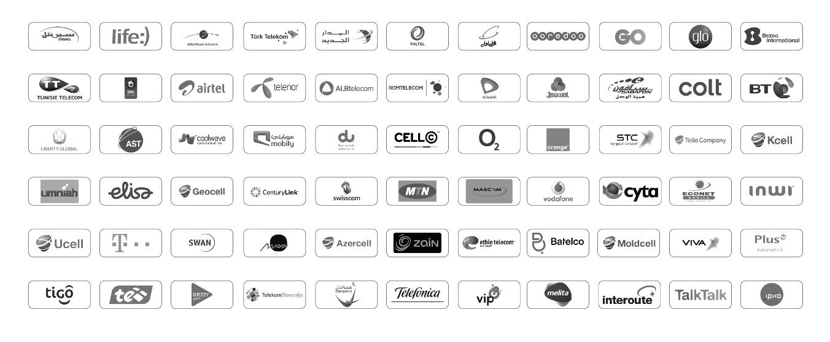
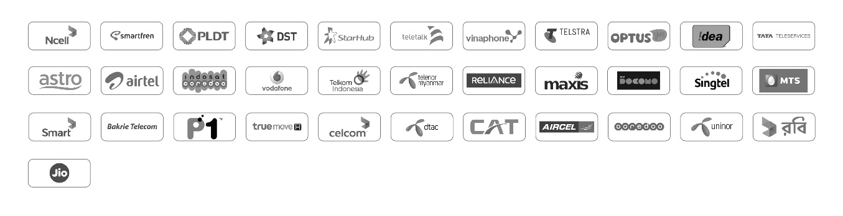
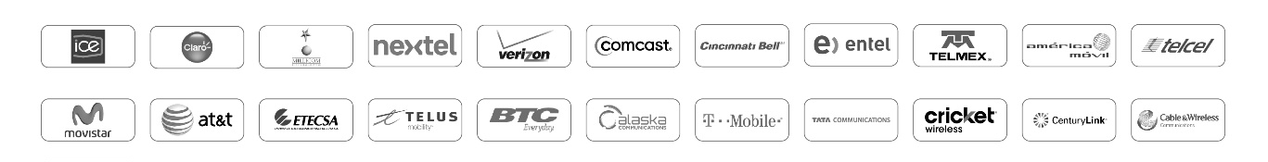
Key Clients
EMEA
200+
Global customers
Asia
300+ Installation in
90+ Countries
Americas

Slide 21
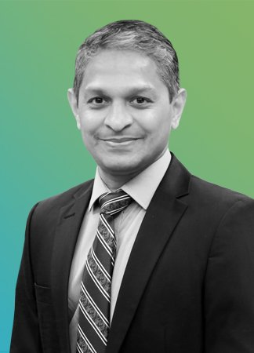
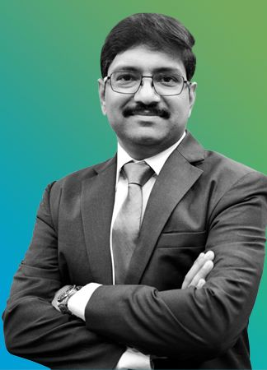
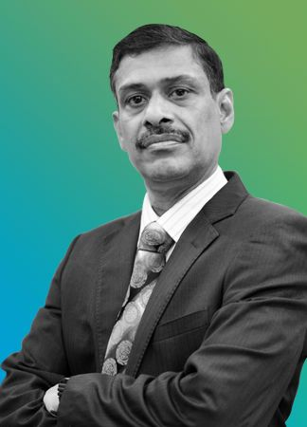
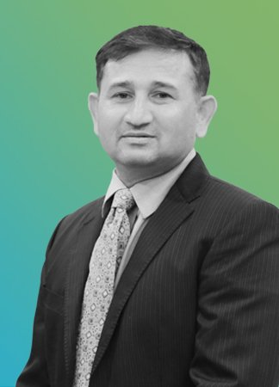
Executive Management Team
Vinod Kumar
Shankar Roddam
Venkatraman GS
Mohan Sitharam
CEO & Managing Director
Chief Operating Officer
Chief Financial Officer
Chief Human Resources Officer
Vinod is responsible for leading the strategic direction for the company and driving its execution by fostering the right culture of leadership and talent development. Prior to becoming the CEO and Managing Director, Vinod served as a COO of Subex where he spearheaded several initiatives that helped the company engage with its customer as a long-term strategic partner. These initiatives, in turn, helped Subex emerge as a global leader in Revenue Management space
Shankar is the Chief Operating Officer, responsible for Sales, Marketing, Engineering and Delivery. He is management professional with close to two and half decades of experience in Telecommunications, Cloud and PaaS. He holds a Management degree from IMDR Pune, with a specialization in Sales & Marketing with minor in Systems. He is an undergrad in Electronics Telecommunications Engineering and is a graduate in Triple Mathematics.
Venkatraman GS is the Chief Financial Officer of Subex and has over 20+ years of industry experience, across all facets of Finance function. He is a B.Com graduate with Honours and holds an MBA degree in Finance. Prior to his current role, he was the Finance Controller for Mindtree. He has worked with large companies like Accenture, Wipro and Pepsi in the past and has experience in the areas of Enterprise Risk Management, Project Financials, Financial Reporting, Business Planning and Management Reporting.
Mohan manages human capital and human resources (HR) functions at Subex. He has nearly two decades of HR experience at Mindtree, HCL, Mphasis, and ANZ. Mohan has rich experience in change management, leadership development, mergers and acquisitions, public listing, global employment norms, and employer branding. He holds both Senior Professional in HR (SPHR) and Global Professional in HR (GPHR) certifications from the HR Certification Institute, Virginia, US.

Slide 22
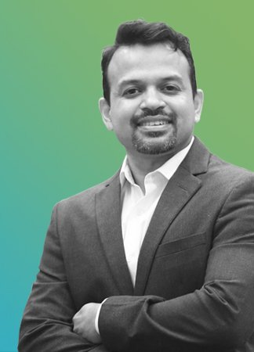
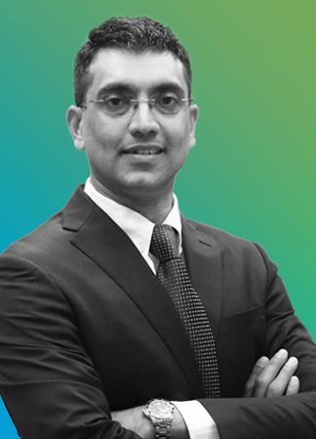
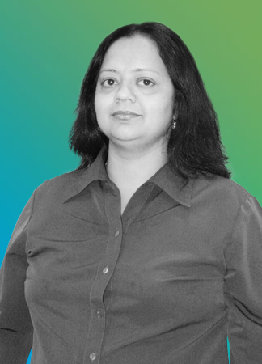
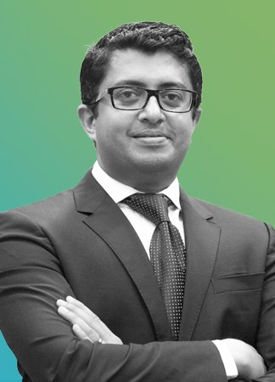
Executive Management Team
Rohit Maheshwari
Kiran Zachariah
Suraj Balachandran
Bhavna Singh
Head of Strategy & Products
Head of IoT security
Head of Sales – EMEA & APAC
General Counsel
Rohit is responsible for delivering business growth using innovation and product strategy. He leverages his expertise in artificial intelligence (AI), analytics and digital services to contribute to Subex’s solutions and enables its clients to build new offerings, drive business growth and deliver great customer experience. Before joining Subex, Rohit worked with companies like Crompton Greaves and Kirloskar Electric Company. He is a graduate in electrical and electronics engineering from University of Mysore
Kiran is a leader in the field of IoT Security Solutions. He is responsible for building and strengthening Subex’s presence in IoT Security by driving revenue growth, setting and executing the strategic and technology direction of IoT Security business, building the current team to capitalize on Subex’s investment in IoT space. He has over 17 years of telecom experience in security, network analytics, machine learning. He also heads Procurement & IT function of Subex.
Suraj is responsible for strategy and direction of Subex’s sales organisation in EMEA & APAC. With 23 years of experience in global ICT industry, he relentlessly focus on forging long term association with customers. In his current role, he works with the Regional Vice Presidents to help them exceed their business goals, by providing effective guidance & executive coverage. Suraj has been previously associated with Jamcracker Inc., Critical Path Inc., and Crompton Greaves Ltd. in sales leadership positions and is a graduate from the Indian Institute of Management, Kozhikode.
Bhavna heads the company’s legal functions. Bhavna has over 20 years of legal experience across major IT corporations like Accenture, Wipro and Sun Microsystems, as well as consulting firms like PwC. She has held senior positions in Contracting and Compliance, with rich experience in Software Products and Technology law.

Slide 23

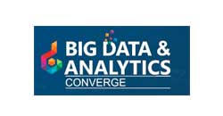





Awards & Recognition
Winner at Aegis Graham Bell Awards 2017 – Data Science
2016
Best Fraud Prevention Project Award
Winner at Converge 2018 - Big Data & Analytics
35+
Industry
recognized
awards
2017 - Innovation in Managed Services and Security & Assurance

Slide 24
investorrelations@subex.com | +91 806659 8700
dpingle@christensenir.com | +91 02242150210

